Slide 1
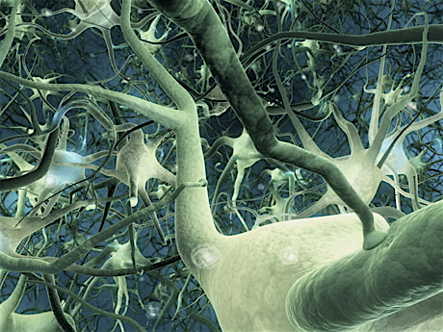
Autism, mental deficiency
and genetics
Laboratory of Molecular Immunology and Embryology
UMR6218 CNRS - University of Orléans –France
Team « Experimental and Molecular Genetics »
Sylvain BRIAULT – sbriault@cnrs-orleans.fr

Slide 2
Autism, Mental retardation and Schizophreni
Background
Genes identified by the team or with participation of the team
Autism
KCNMA1
Mental
Retardation
SOX3
PHF8
GPD2
NLGN4
EOMES
MED12
PRSS12
OPN1
UPF3B
Published in Biol. Psychiatry - Mol Psychiatry - Hum Genet - J Med Genet - Nat Genet - Am J Psychiatry - Am J Hum Genet – Science - Nature…

Slide 3
Axes
Identification of genes involved in autism and/or mental retardation
Investigation of the physiopathology of selected genes using complementary approaches (biochemistry, electrophysiology, functional approaches, animal models…)
Development and evaluation of diagnostic tools and novel therapies
Neuroinflammation

Slide 4
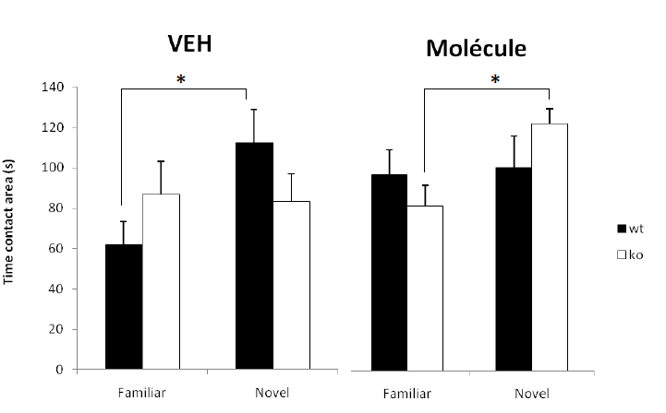
Therapy: the GKTM molecule
Fmr1 KO mice
Treatment with the GKTM molecule
➔ The deficit is partially corrected
Patent in progress

Slide 5
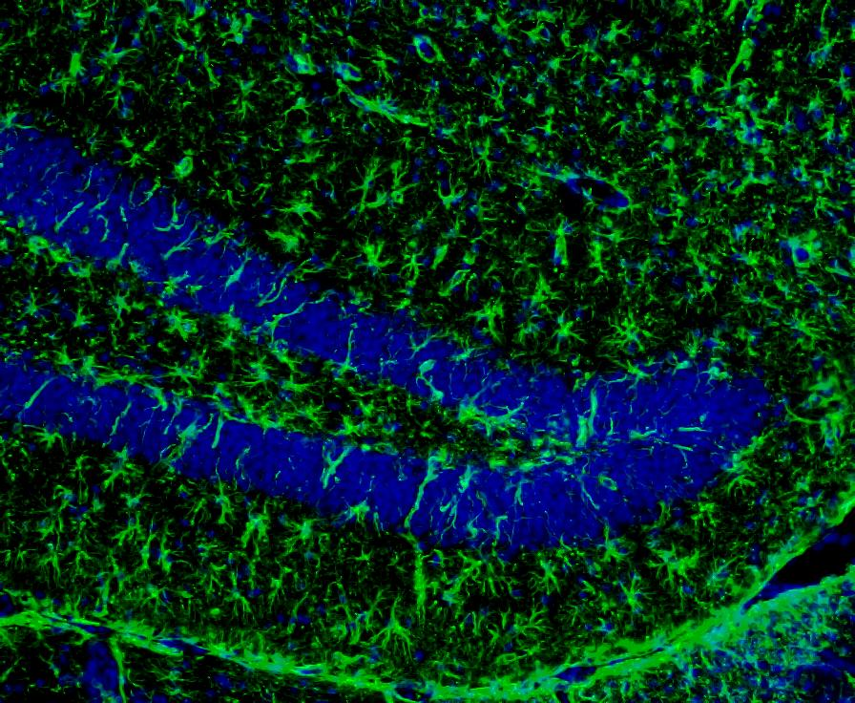
Focus 4: Transversal Project
Neuroinflammation : a transversal project
Neuroinflammation
Role of TNF, IL-6, IL-1, IL-17...
Tools
Neutralization by Abs
Gene deficient mice
Transcriptomic studies.

Slide 6
Collaborations
Molecular Biophysics Center - UPR 4301 – Orleans
Research Institute in Fine Organic Chemistry – Rouen
Cognitive and Integrative Neuroscience - CNRS UMR 5287 - Bordeaux
UMR INSERM U 930 - CNRS FRE 2448 – Tours
Genome Institute of Singapore

Slide 7
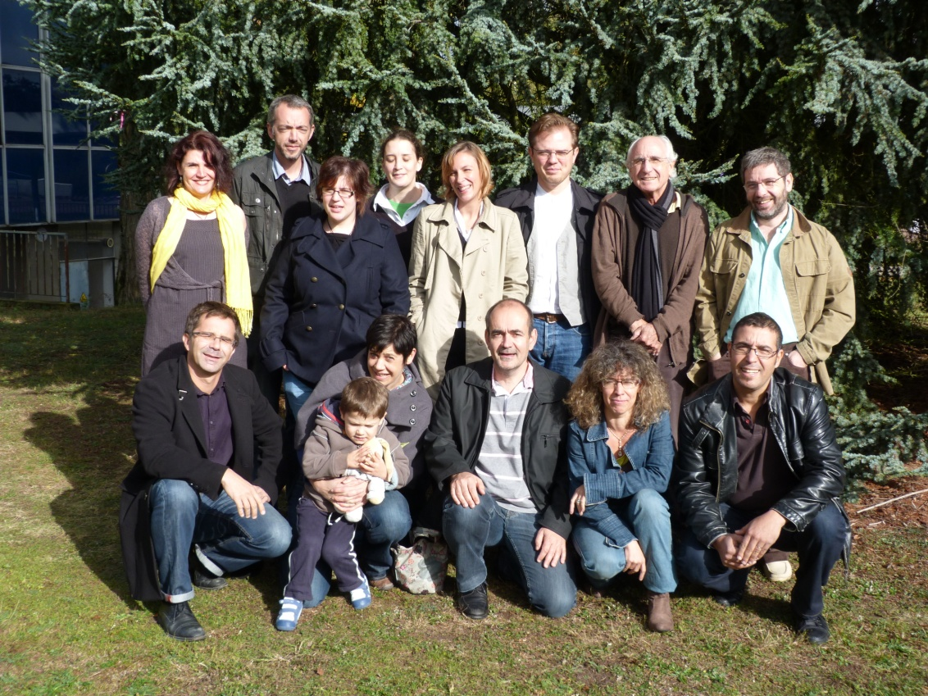
Laboratory of Molecular Immunology and Embryology -UMR 6218 CNRS - University of Orléans
Team “Experimental and Molecular Genetics“ http://transgenose.cnrs-orleans.fr/iem
sbriault@cnrs-orleans.fr
S Briault, MD, PhD,
B Laudier, MD,
J Pichon, Professor,
M Ardourel, Assistant Professor,
A Menuet, Assistant Professor,
S Mortaud, Assistant Professor,
C Montecot, Assistant Professor,
O Richard, Assistant Professor,
L Baala, PhD, Engineer,
M Fauconnier, PhD,
O Perche, PhD, postdoctoral fellow,
B Hebert, PhD Student,
M Marcos, Assistant Engineer.

